Slide 1

Masdar Institute of Science and Technology

Slide 2

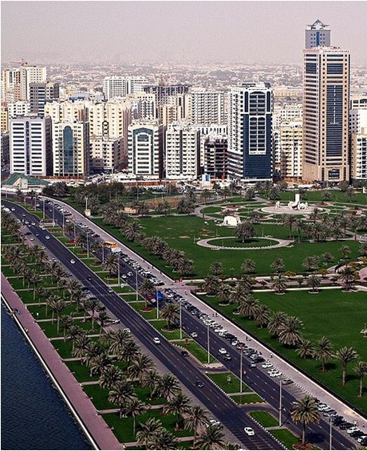
Abu Dhabi Vision
Sustainable economic growth, and the development of human capital.
One of the projects is the Masdar Initiative

Slide 3
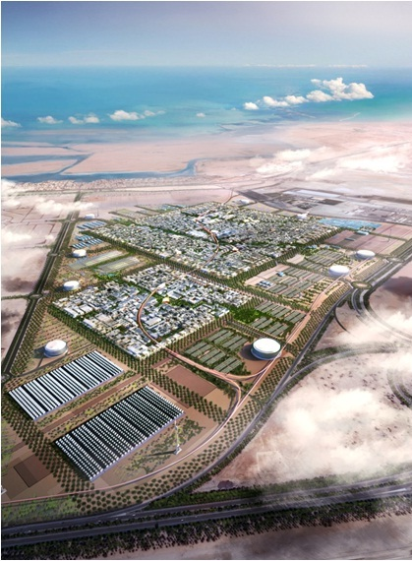
Masdar Initiative
A global cooperative platform to search for solutions to energy security, climate change and the development of human expertise in sustainability.
Aims to position Abu Dhabi as a world-class research and development hub for new energy technologies.

Slide 4

Masdar Institute Overview
Established by the Government of Abu Dhabi
With the support and cooperation of Massachusetts Institute of Technology (MIT).
An independent, non-profit, research-driven graduate institution.
To help Abu Dhabi become a knowledge-led economy.
To research and develop alternative energies and sustainable technologies.

Slide 5
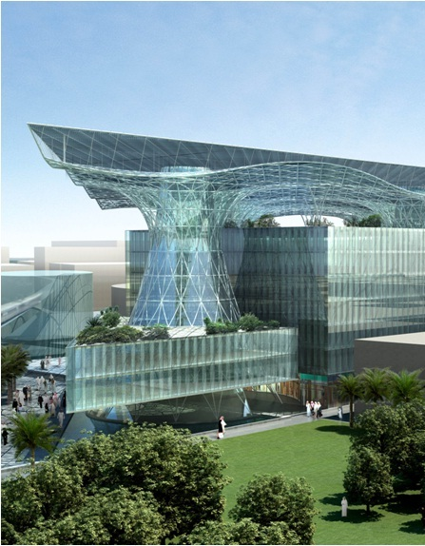
Relationship with Masdar City
Masdar Institute will be the first tenant of Masdar City
Offers faculty and students a unique platform to test alternative energy and sustainability technologies
A ‘living laboratory’ providing an unparalleled opportunity for the entire spectrum of research from theory to applied research to commercialization in a single location.

Slide 6
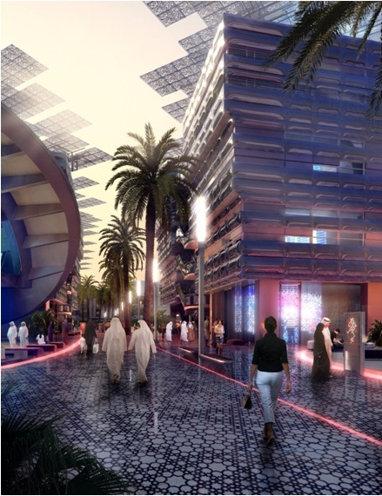
Vision of Masdar Institute
To become a world-class graduate research and education institution, providing future leaders and critical thinkers in science and technology.
To innovate and develop new solutions in the areas of alternative and renewable energy, and sustainability technologies.
To promote the development of human capital in the UAE, and to become a knowledge exporter.
Inaugural intake of 88 students – selected from over 1,000 applications – commenced classes in five Master’s programs in September.

Slide 7
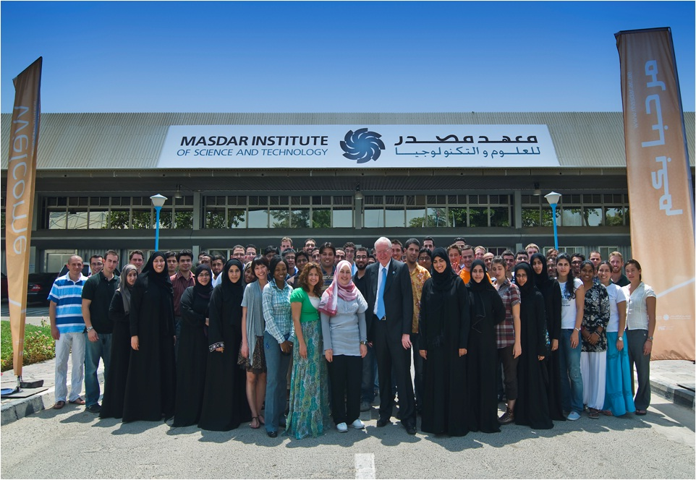
Provost Dr John Perkins with
the inaugural intake, Sept 2009

Slide 8
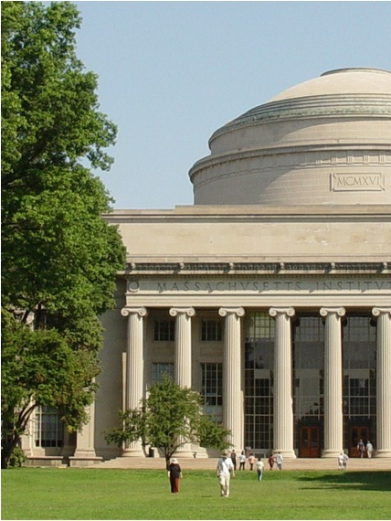
Relationship with MIT
MIT contributes to development of degree programs and curriculum, provide Masdar Institute graduates with a certificate
MIT assists in faculty and senior administration recruitment.
Collaborative research by MIT and Masdar Institute faculty.
MIT’s impressive reputation in both the academic and business worlds lends credibility to Masdar Institute.
Notes:
MIT ranking http://web.mit.edu/newsoffice/2009/usnews-0820.html

Slide 9
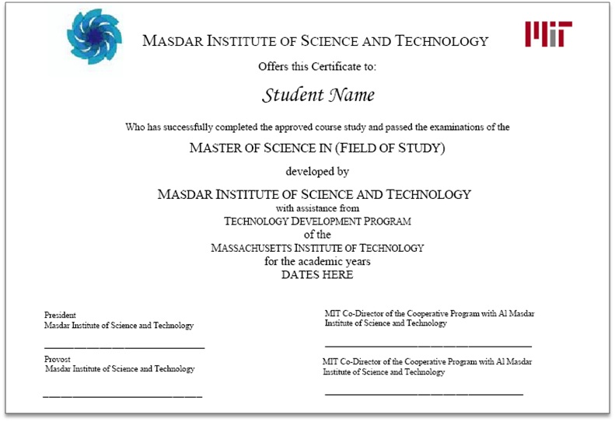
Degree from Masdar Institute
Certificate from MIT
Notes:
MIT ranking http://web.mit.edu/newsoffice/2009/usnews-0820.html

Slide 10
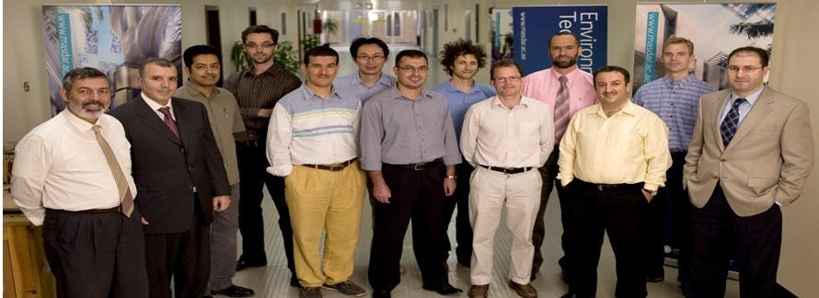
Masdar Institute Faculty
Farrukh Ahmad – PhD Rice U
Peter Armstrong – PhD MIT
Matteo Chiesa – PhD Norwegian U of Sc &
Technology
Jacob Crandall – PhD Brigham Young U
Ali Diabat – PhD Purdue U
Clara Dimas – PhD Lehigh U
Mahieddine Emziane – PhD U of Nantes
Hassan Fath – PhD McMaster U
Raed Hashaikeh – PhD McGill U
Isam Janajreh – PhD Virginia Polytechnic Inst
Scott Kennedy – PhD Harvard U
Marwan Khraisheh – PhD Washington State U
Toufic Mezher – PhD George Washington U
Sgouris Sgouridis – PhD MIT
Youssef Shatilla – DSc MIT
Davor Svetinovic – PhD U of Waterloo
Ali Tabaei – PhD MIT
I-Tsung Tsai – PhD MIT
Georgeta Vidican – PhD MIT
Wei Lee Woon – PhD Aston U
Hatem Zeineldin – PhD U of Waterloo
Notes:
MIT ranking http://web.mit.edu/newsoffice/2009/usnews-0820.html

Slide 11
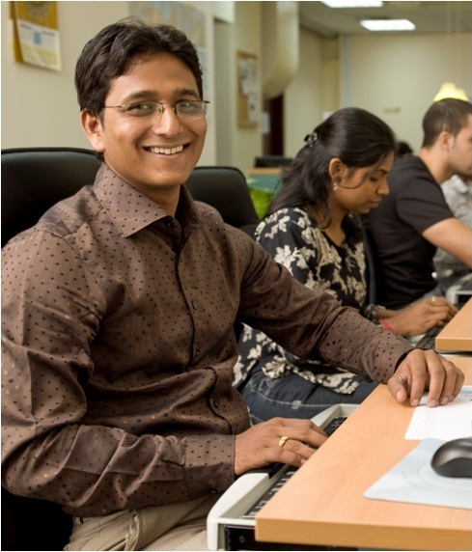
Academic program components
Academic
Coursework - technical and analytical skills
Seminars, training sessions, workshops
Research
Thesis - deep expertise in a topic of regional and/or global importance
Multidisciplinary collaboration - broad perspectives on academia and industry
Notes:
MIT ranking http://web.mit.edu/newsoffice/2009/usnews-0820.html

Slide 12
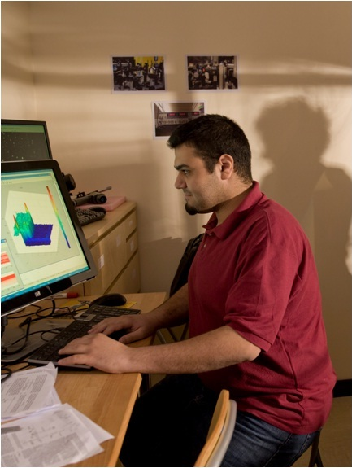
Academic program
2009/2010 academic year
MSc Engineering Systems & Management
MSc Information Technology
MSc Materials Science & Engineering
MSc Mechanical Engineering
MSc Water and Environmental Engineering
Notes:
MIT ranking http://web.mit.edu/newsoffice/2009/usnews-0820.html

Slide 13
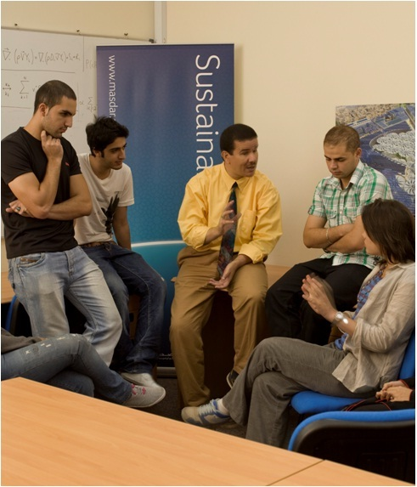
Academic program
2010/2011 academic year
Two new MSc programs
MSc Electrical Power Engineering
MSc Microsystems
2010/2011 academic year
New PhD programs
Notes:
MIT ranking http://web.mit.edu/newsoffice/2009/usnews-0820.html

Slide 14
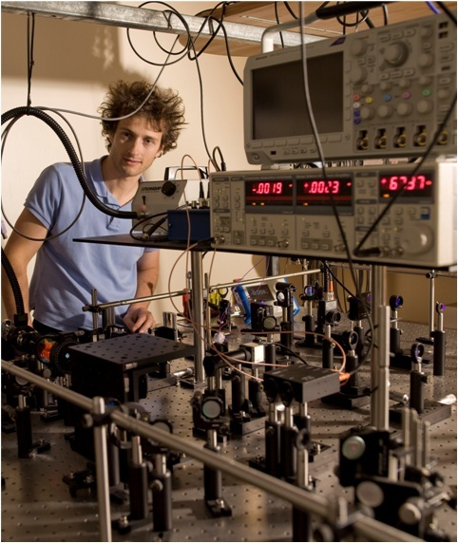
Research
New research is a key element of the Masdar Institute educational experience.
Each student must complete an original thesis on a research topic of his or her choosing, with the approval and supervision of the program advisor.
Collaboration across programs is encouraged in order to foster an intellectually stimulating environment that supports innovation
Notes:
MIT ranking http://web.mit.edu/newsoffice/2009/usnews-0820.html

Slide 15
Research
Technology
Policy
Systems
Solar Thermo-
Electric
Thin-film Solar
Fuel Cells
Marine Energy
Building
Technology
Waste to Energy
Nuclear
Technology
Forecasting
Economics of
Sustainability
Technology
Strategy
Transport
Energy
Markets
Distributed
Generation
Innovation
Notes:
MIT ranking http://web.mit.edu/newsoffice/2009/usnews-0820.html

Slide 16
Technology Focus Areas
Energy Efficiency and Energy Conversion
Advanced Materials
Photovoltaic materials
Water and Environment
Desalination devices
Photovoltaic devices
Waste-to-energy
Nuclear energy
Marine energy
Fuel cells
Batteries
Thermoelectric materials
Biomaterials
Nanostructured materials
Lightweight alloys
Materials processing and fabrication, including micro- and nano- fabrication
Water purification and filtration devices
Advanced membranes
Advanced metering for efficient water use
Air quality monitoring and control
Bio and Phytoremediation
Solid-state lighting
Functionally graded materials
Building technologies
Bioconversion
Intelligent sensors
Notes:
MIT ranking http://web.mit.edu/newsoffice/2009/usnews-0820.html

Slide 17
Policy Focus Areas
Technology Strategy
Global Climate Change
Human health
Energy and Emissions Markets
Renewable energy forecasting
Energy distribution and consumption
Innovation Systems
Innovation ecosystems
Water distribution and consumption
Renewable and sustainable technology investment
Agriculture
Sustainable development
Carbon management
Demand response
Micro-grids
Distributed Energy Resources
Carbon markets
Innovation measurement
Science, technology, and innovation policy
Notes:
MIT ranking http://web.mit.edu/newsoffice/2009/usnews-0820.html

Slide 18
System Focus Areas
Energy Generation and Transmission
Sustainable Transportation and Urban Development
Sustainable aviation
Information Systems
Technology forecasting
Electricity transmission networks
Sustainable Design and Manufacturing
Lean manufacturing and operations
Large-scale electricity generation using renewable and sustainable resources
Sustainable cities
Green (carbon-optimized) supply chains
Distributed computing and data storage
Green (energy efficient) information technology and sustainable computing
Life cycle analysis
Models for sustainable manufacturing
Recovery, reuse, remanufacturing, and recycling of components and devices
Notes:
MIT ranking http://web.mit.edu/newsoffice/2009/usnews-0820.html

Slide 19
Technology Focus Areas
Energy Efficiency and Energy Conversion
Advanced Materials
Photovoltaic materials
Water and Environment
Desalination devices
Photovoltaic devices
Waste-to-energy
Nuclear energy
Marine energy
Fuel cells
Batteries
Thermoelectric materials
Biomaterials
Nanostructured materials
Lightweight alloys
Materials processing and fabrication, including micro- and nano- fabrication
Water purification and filtration devices
Advanced membranes
Advanced metering for efficient water use
Air quality monitoring and control
Bio and Phytoremediation
Solid-state lighting
Functionally graded materials
Building technologies
Bioconversion
Intelligent sensors
Notes:
MIT ranking http://web.mit.edu/newsoffice/2009/usnews-0820.html

Slide 20
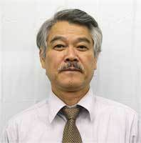
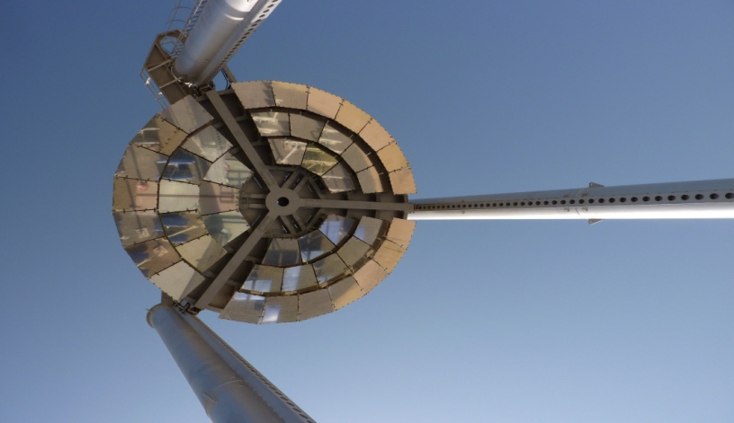

Beam Down Solar Concentrator
Y. Tamaura (TiTech)
M. Chiesa (MIST Marwan, Irene, Steven)
Research Objectives
Broader Impact
Demonstrate that the Beam-down lay out characterized by multi-ring central reflectors yields:
Over 600℃ HTF available to Power Generator
Ground level Receiver with easy maintenance
High solar flux (Sun Beam from every direction can be stably - concentrated to one small area.)
Establish a platform for research within solar thermal technology.
This objective is in line with the Masdar vision of making Abu Dhabi the preeminent source of renewable energy knowledge, development, implementation and the world's benchmark for sustainable development.
Multi – ring central reflector
STG cell prototype

Slide 21
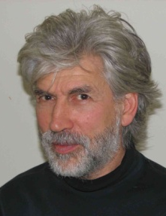
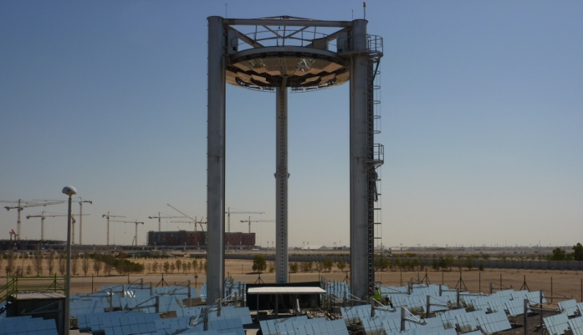
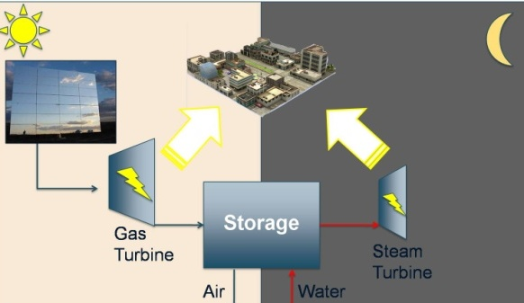
Combined Cycle Concentrated Solar Power with Energy Storage for Base Load Grid Availability
Peter Armstrong Steven Meyers
Research Description
A 24 hour-combined-cycle power plant is being developed at the Masdar Institute which consists of two turbines, gas and steam, for electricity generation. Thermal storage is provided by a Thermal Energy Storage (TES) device, which is combination heat exchanger/thermal storage medium using sensible and latent heat. Each turbine’s use is determined by matching the demand and the base load of the grid. Generally, the gas turbine will provide peak load electricity during the daytime, whereas the steam turbine will operate 24 hours a day, providing base load electricity.
The solar concentration array (Figure 1) heats the working fluid (air) to a temperature of 1000C, causing rapid expansion through the gas turbine generator. Depending on the time of day and grid demand, the exhaust gas (at 500C) is then diverted to either heat the TES for nighttime storage or to the steam turbine heat exchanger for a normal combined cycle operation. After sundown, the steam cycle will continue operation only using the thermal energy stored in the TES device (Figure 2). Proper choice of the turbine size, TES components and design, heliostat field, and control systems will make this project technologically feasible.
Importance
Wide implementation of this technology will decrease the country’s carbon footprint and reduce cooling loads in the summer. The consistent solar electricity generation allows the utility company to decrease fossil fuel consumption for peak summer cooling demands. During the winter months when cooling load is significantly lower, fossil fuel power plants can essentially be turned off.
Figure 1 – The Beam Down Solar Power Plant at Masdar City
Figure 2 – Model of the 24 Hour Solar Power Design at the Masdar Institute

Slide 22
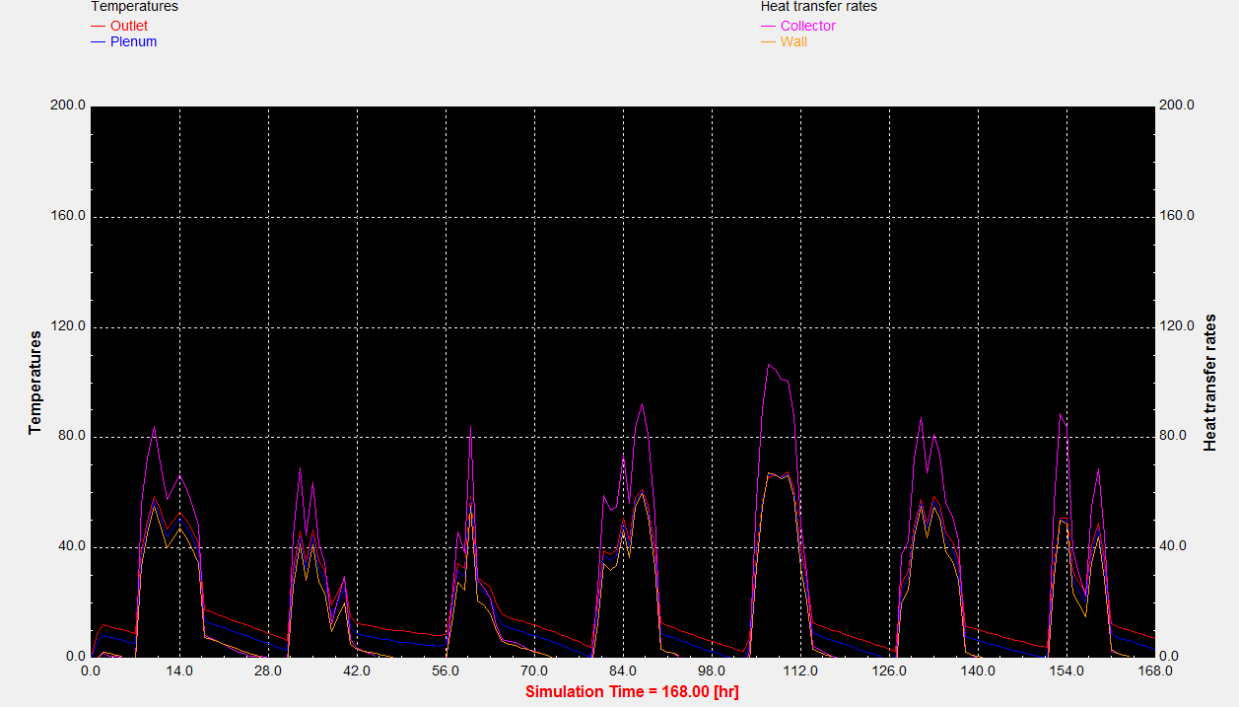
Unglazed Transpired Air Collector(UTAC) for Desiccant Regeneration
Advisor: Dr. Peter Armstrong Student: Abdul Qadir
Research Objectives
-Develop through simulation and testing, an UTAC which can deliver an outlet air temperature of 70˚C in order to regenerate a desiccant for desiccant cooling and dehumidification cycles.
Investigate a hybrid UTAC to produce hot water & air.
- Develop an integrated model and test the performance of a desiccant cooling cycle coupled with a UTAC.
Broader Impacts
Could replace the gas burners which are currently used to regenerate desiccants.
Cost effective way to integrate solar technology to an existing cooling infrastructure.
Can significantly reduce the electricity consumption by removing latent cooling load from the cooling system, especially in humid climates like Abu Dhabi’s.
Perforated plate
Air being sucked
Heated air to desiccant cycle
Building Roof
Fan
Figure 1: Schematic of the UTAC configuration
Figure 2: Initial TRNSYS simulation results

Slide 23
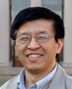
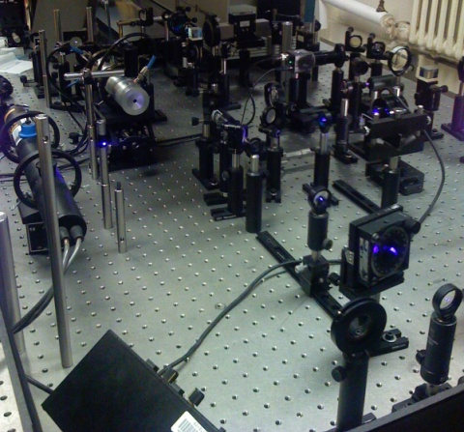
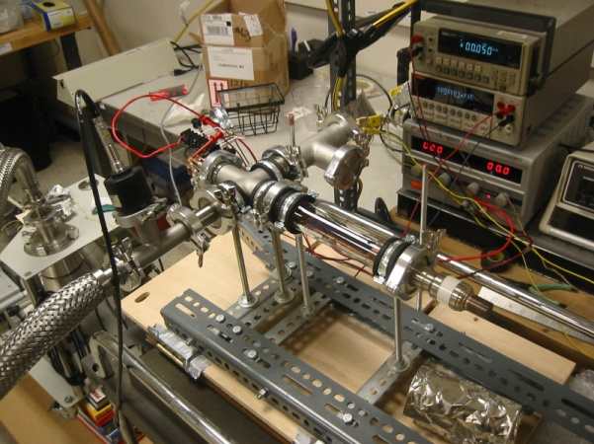
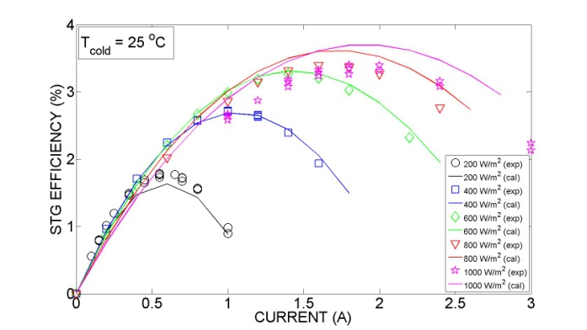
Hybrid Solar Thermoelectric and Photovoltaic Energy Conversion
G. Chen (MIT Daniel, Anurag )
M. Chiesa (MIST Ramez, Hadi)
Research Objectives
Accomplishments
Hybrid solar thermoelectric modelling and cell fabrication
Design modelling and fabrication of frequency selective surfaces
Design and fabrication of high efficient hybrid system.
A methodology for the design of high performance hybrid
system was proposed.
A solar thermoelectric generator prototype has been
constructed and performance tests are in progress.
The effect of surface plasmons are explored from a
theoretical and experimental point of view for the
development of frequency selective surfaces.
Material characterization
System
modelling & design
STG cell prototype
Notes:
Description: We are investigating hybrid technology that combines photovoltaics with thermoelectrics to convert solar light into electric energy. In brief the rationale behind hybrid systems is to fully harness the energy embedded in the incoming solar radiation by combining a photovoltaic (PV) module with its narrow absorption wavelength range with a thermoelectric (TE) generator characterized by constant conversion efficiency in the whole solar radiation spectrum.
Objective and Approach: The primary objective of our investigation is on the development of a prototype hybrid PV and TE devices that have the potential of low-cost and high efficiency. System design and optimization needs to be carried out in order to determine the devices and system configurations. The modeling will provide guidance for experiments. There are very few works so far on the above-discussed ideas, this underlines the novelty of our project although there implies also little work carried out on both modeling and experimental characterization.
Preliminary Results:
Design of hybrid system: We have developed a methodology aimed at designing an optimized hybrid system with the highest possible solar energy to electricity transformation efficiency. The method provides the design constrains for the design of selective mirrors that split the broad solar spectrum into two parts: one directed to the PV element and one directed to the TE module. It gives the guideline for the combination of PV and STG modules in the most efficient way and enables to realize the full potential of such hybrid systems. This refers to the Figure in the middle of the slide (System modeling & design). Our model uses the experimental external quantum efficiency (EQE) data for a specific solar cell module and the reported efficiency of STG. Our approach can be extended to different configuration as long as one can provide EQE data.
Solar TE Modeling and Cell Fabrication
A solar thermoelectric generator prototype is under construction and it will be shortly tested. We wish to obtain efficiency results for the STG module using nanostructured material with an improved figure of merit ZT. The figure on the right hand side of the slide (STG cell prototype) shows the first prototype that has been development and is currently under testing. We have achieved an energy conversion efficiency above what has ever been reported before with bulk TE materials. We are now investigating a new material and we believe we can obtain efficiency close to 5%. The test results were in good agreement with our modeling that describes the efficiency of the STG taking into account for the radiation and conductive losses within our system and the material properties of the thermoelectric employed.
Material Characterization The efficiency of STG depends strongly on the material properties of the thermoelectric module and on the selective surfaces. We employ picosecond ultrasonics technique see the figure on the left hand side of the slide (Material characterization). Such technique is based on the optical generation and detection of acoustic phonons and it is used to characterize transport and structural properties of novel materials and nanostructures such as thin films or nanocomposite materials. These properties are needed to design high efficiency energy conversion technologies.
Design and fabrication of frequency selective surfaces
We have been exploring the idea of using surface plasmons to enhance surface absorption in the solar spectrum while minimizing thermal emission at STC operation temperature.
As a first step, we investigated theoretically the surface-plasmon enhanced light absorption in silicon. Our modeling results show the wavelength dependent enhancement
factors for particles with different radii.

Slide 24

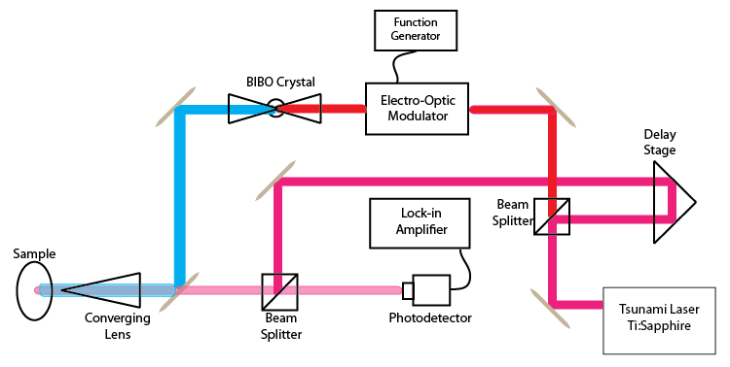
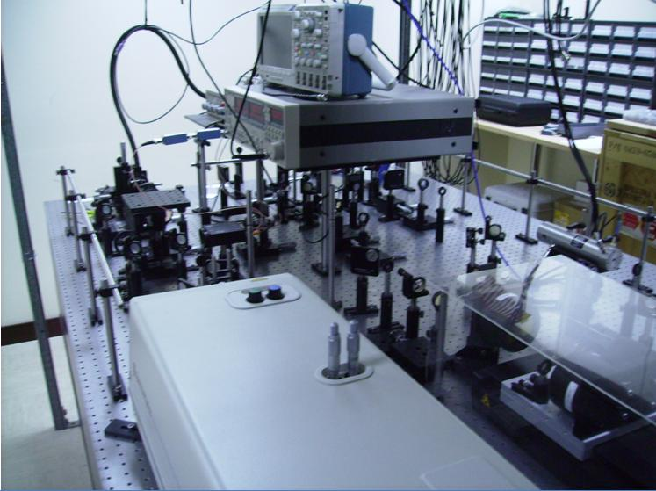
Novel Method for the
Characterization of Thin Films
Dr. Matteo Chiesa
R. Cheaito
Research Objectives:
Further develop experiments for the characterization of thin films by means of optical technique.
Understand the energy transfer mechanisms and thermal properties of thin films is important
Relevance to Masdar Initiative:
The techniques can be used to test thin film used in for the PV module of Masdar PV
The frequency domain measurement can be build around continuum laser leading to a consistent cost reduction
LENS Laboratory
Frequency measurement
Pump probe scheme

Slide 25
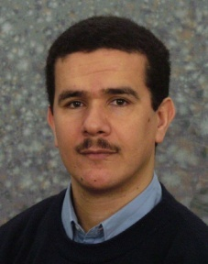
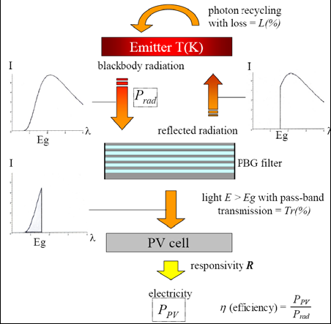
Design, optimization and demonstration of low-cost devices for thermophotovoltaics
Co-Principal Investigators: Mahieddine Emziane
R.J. Nicholas (Oxford University, UK).
Funded by the British Council (UK) through the PMI2C Initiative
Research Objectives:
● Provide optimized designs of TPV cells for the most promising and cost-effective selective emitters.
● Propose effective ways to grow
and fabricate such optimized TPV devices.
● Implement and assess the most-efficient TPV device that has the lowest cost, for the purpose of demonstration.
Relevance to Masdar:
● Various and limitless applications given the natural solar heat available in the UAE.
Schematic of a TPV system with Filter and SE.

Slide 26
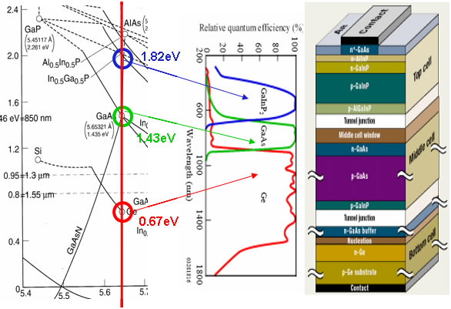
Multi-Junction Solar Cells
Principal Investigator: Mahieddine Emziane
Student: A. Sleiman
Research Objectives:
● Design of low-cost high-performance double and multi-junction solar cells.
● Achieve a maximum absorption from a broad incident spectrum.
● Demonstrate such novel devices.
Broader Impact:
● MIST contribution to the 3rd generation PV
devices through multi-junction cells.
A triple-junction solar cell.

Slide 27
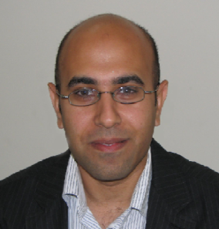
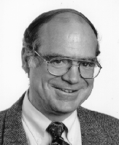
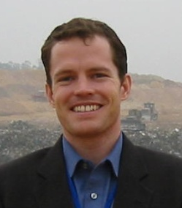
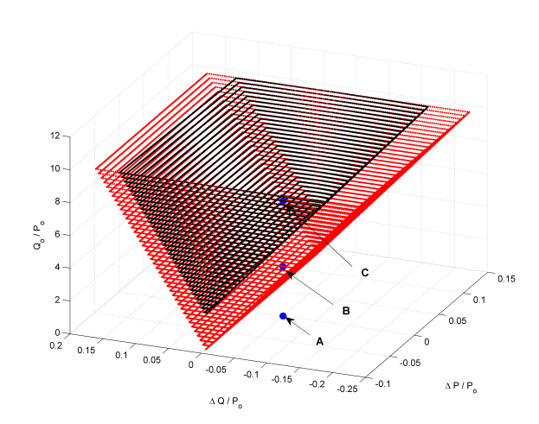
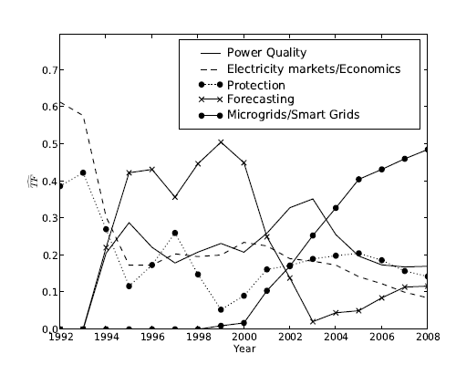
Integration of Renewable Energy Sources
in Power Systems
James Kirtley(MIT)
Hatem Zeineldin(MIST) and Scott Kennedy (MIST)
Project Team: Nadim Kanaan, Ahmed Saif, Waleed Najy and Dr. Ali Alaboudy
Project Objectives
Accomplishments
Develop control and protection schemes that will facilitate wide spread integration of micro-grids.
Analyzing and mitigate the impacts of renewable energy sources on power systems.
Developing a new simple and easy to implement islanding detection method with negligible Non-detection Zones.
Optimal location for fault current limiters to manage faults levels for smart grids.

Slide 28
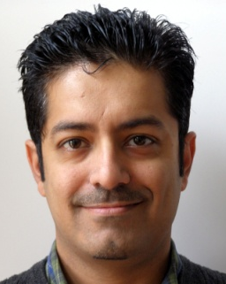
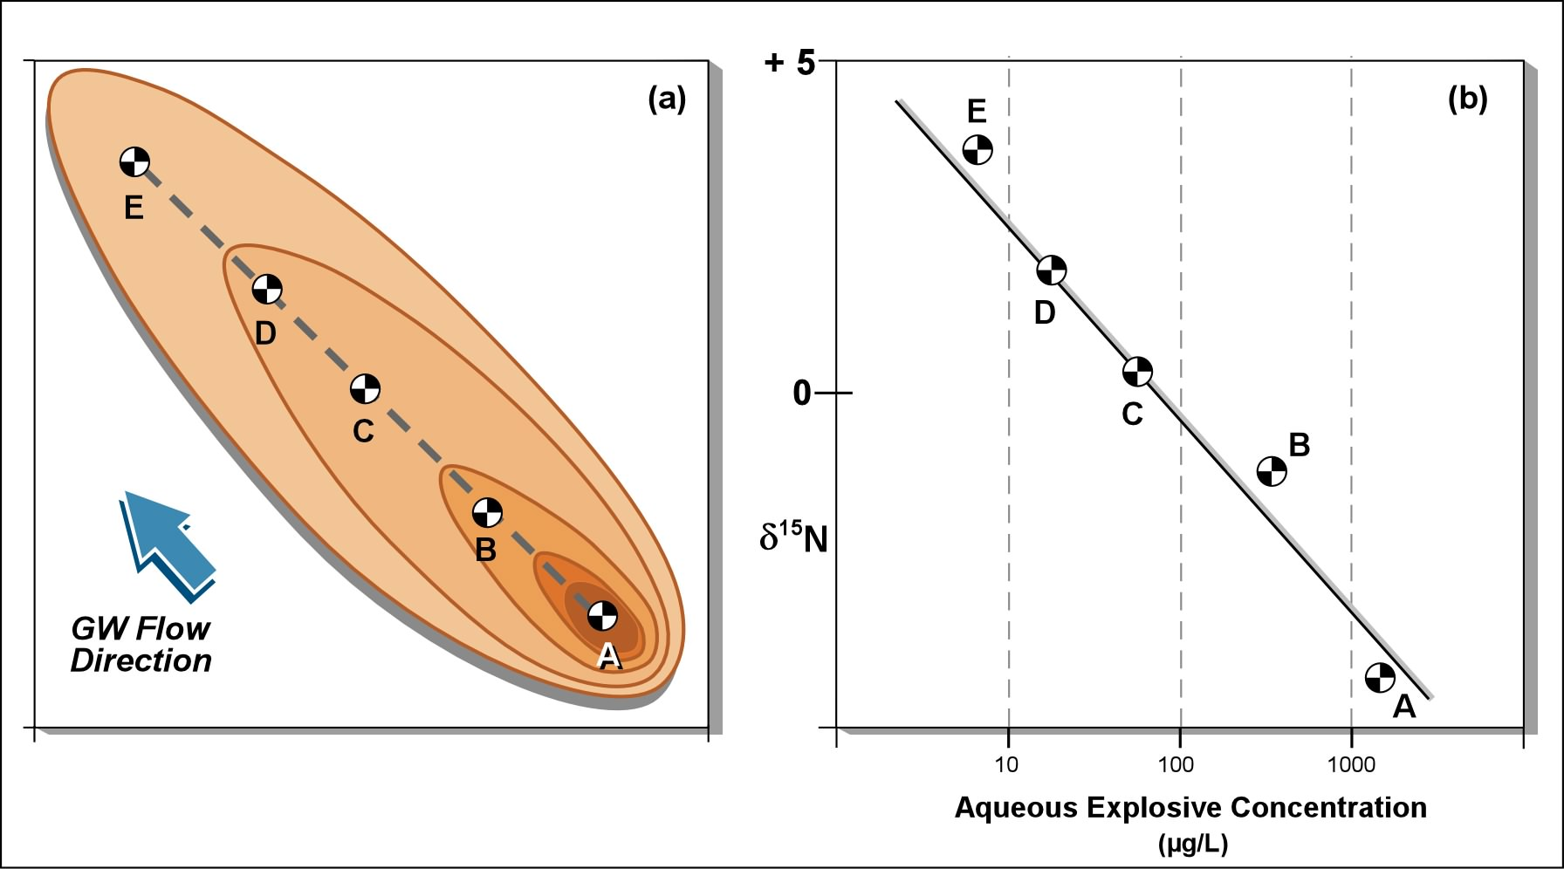
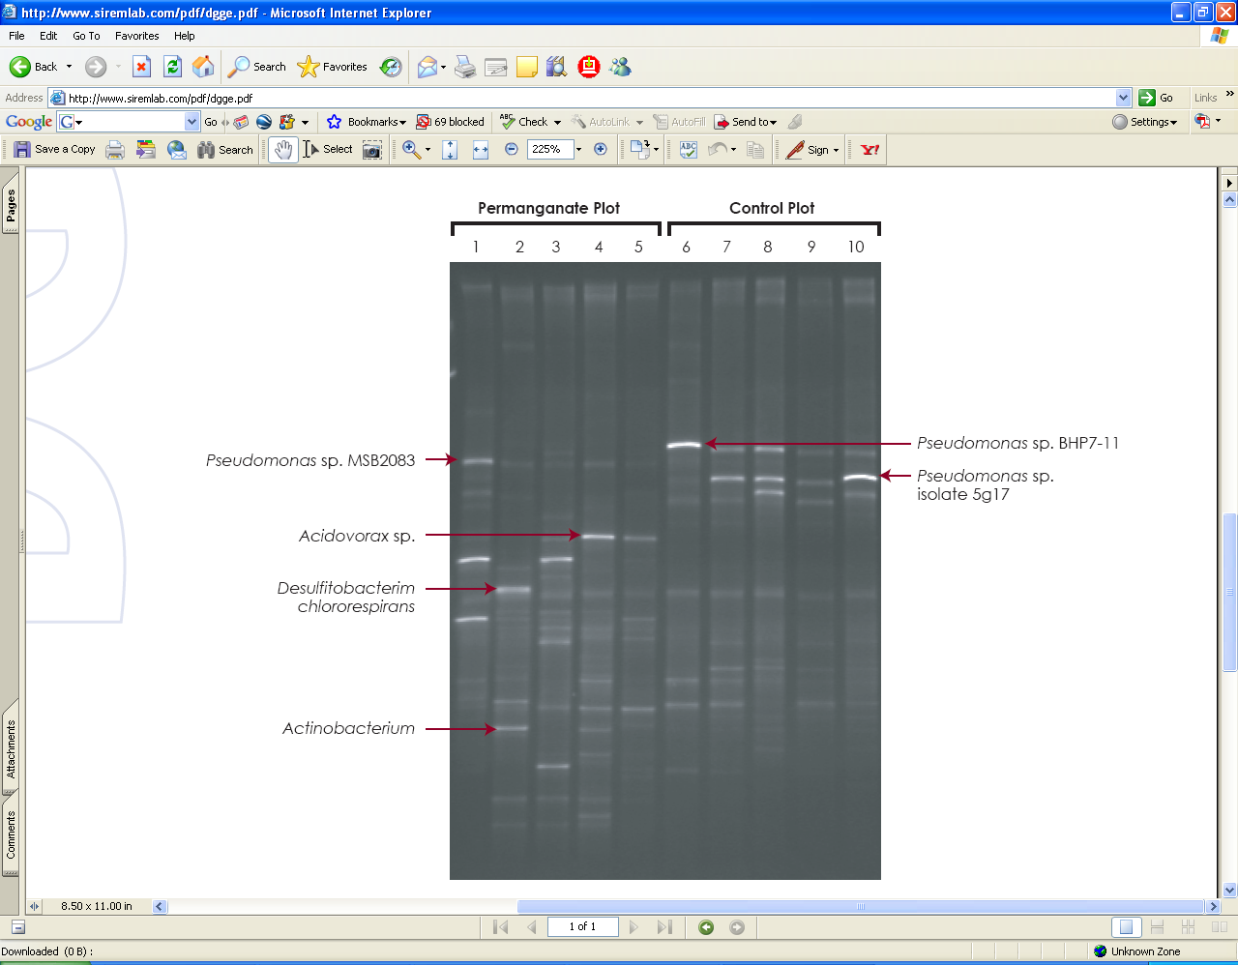
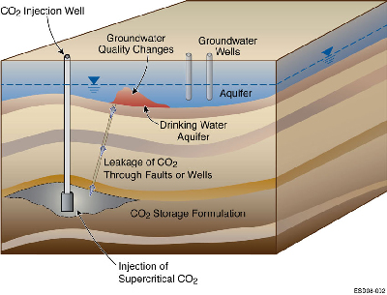
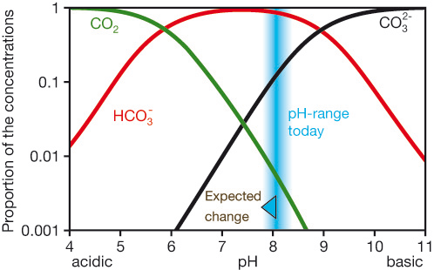
Fate & Transport of Inorganic Contaminants
in Natural & Engineered Environments
Advanced Techniques for Monitoring Anionic Contaminants in
Waste Streams, Natural Environments, and Reused Water
Farrukh Ahmad (PI, MIST), Ali Farhat (Student, MIST)
Project Objectives
Development of stable isotope ion fingerprinting methods using IC/Triple Quad MS for the following applications:
Monitoring ionic contaminant transformation in GW
Monitoring influx of sequestered pyrogenic CO2 into GW
Surrogate ionic parameters for predicting trace pollutant enrichment in reused water streams

Slide 29
Policy Focus Areas
Technology Strategy
Global Climate Change
Human health
Energy and Emissions Markets
Renewable energy forecasting
Energy distribution and consumption
Innovation Systems
Innovation ecosystems
Water distribution and consumption
Renewable and sustainable technology investment
Agriculture
Sustainable development
Carbon management
Demand response
Micro-grids
Distributed Energy Resources
Carbon markets
Innovation measurement
Science, technology, and innovation policy
Notes:
MIT ranking http://web.mit.edu/newsoffice/2009/usnews-0820.html

Slide 30
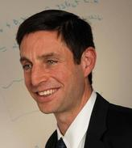
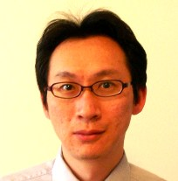
Modeling and Predicting the Cost of Climate Change on Health
Michael Greenstone (MIT)
I-Tsung Tsai (MIST)
Research Objectives
Broader Impact
Estimate the impacts of climate change on mortality and health-preserving adaptations
Forecast the Effects of Different International Carbon Regulation Regimes on Human Health
Facilitate the development of efficient public health policies to cope with climate change in the region.
Facilitate the design of an optimal global regulatory system for greenhouse gas emission.
Notes:
.

Slide 31
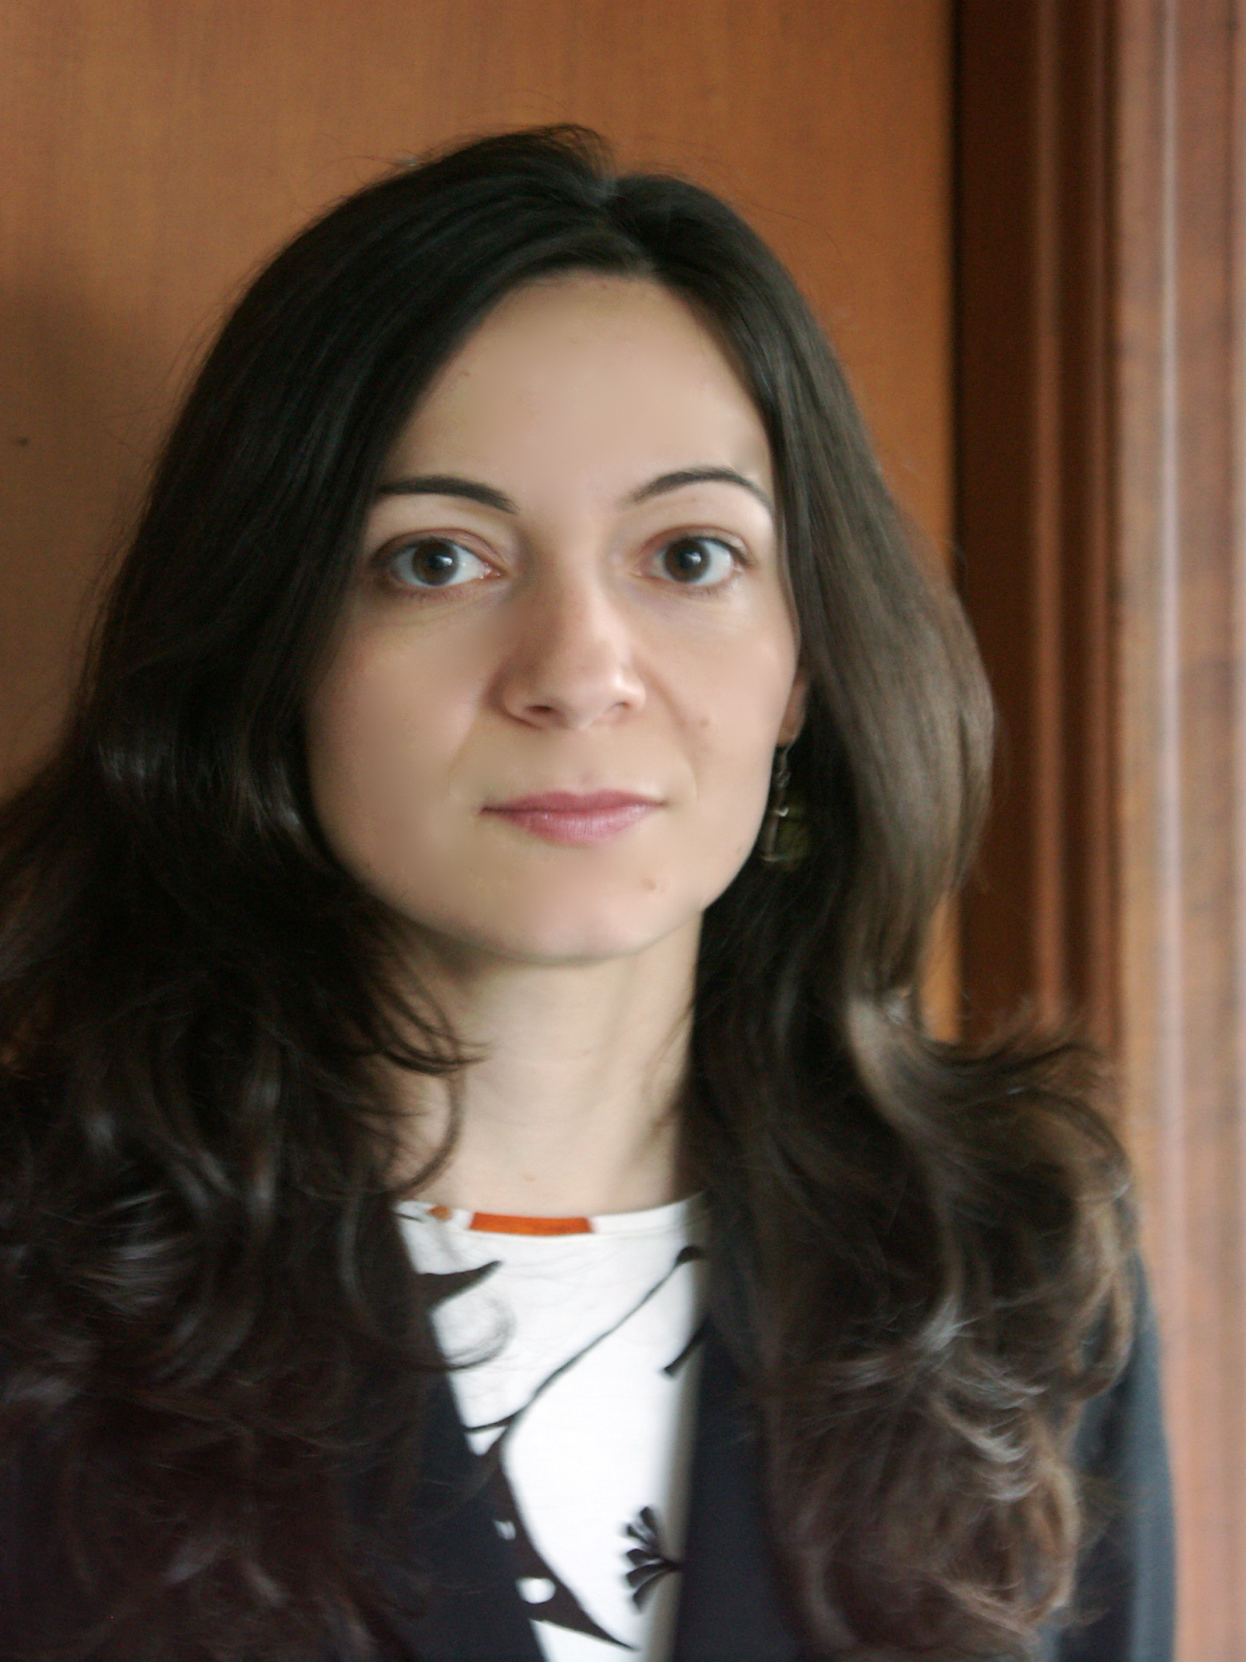
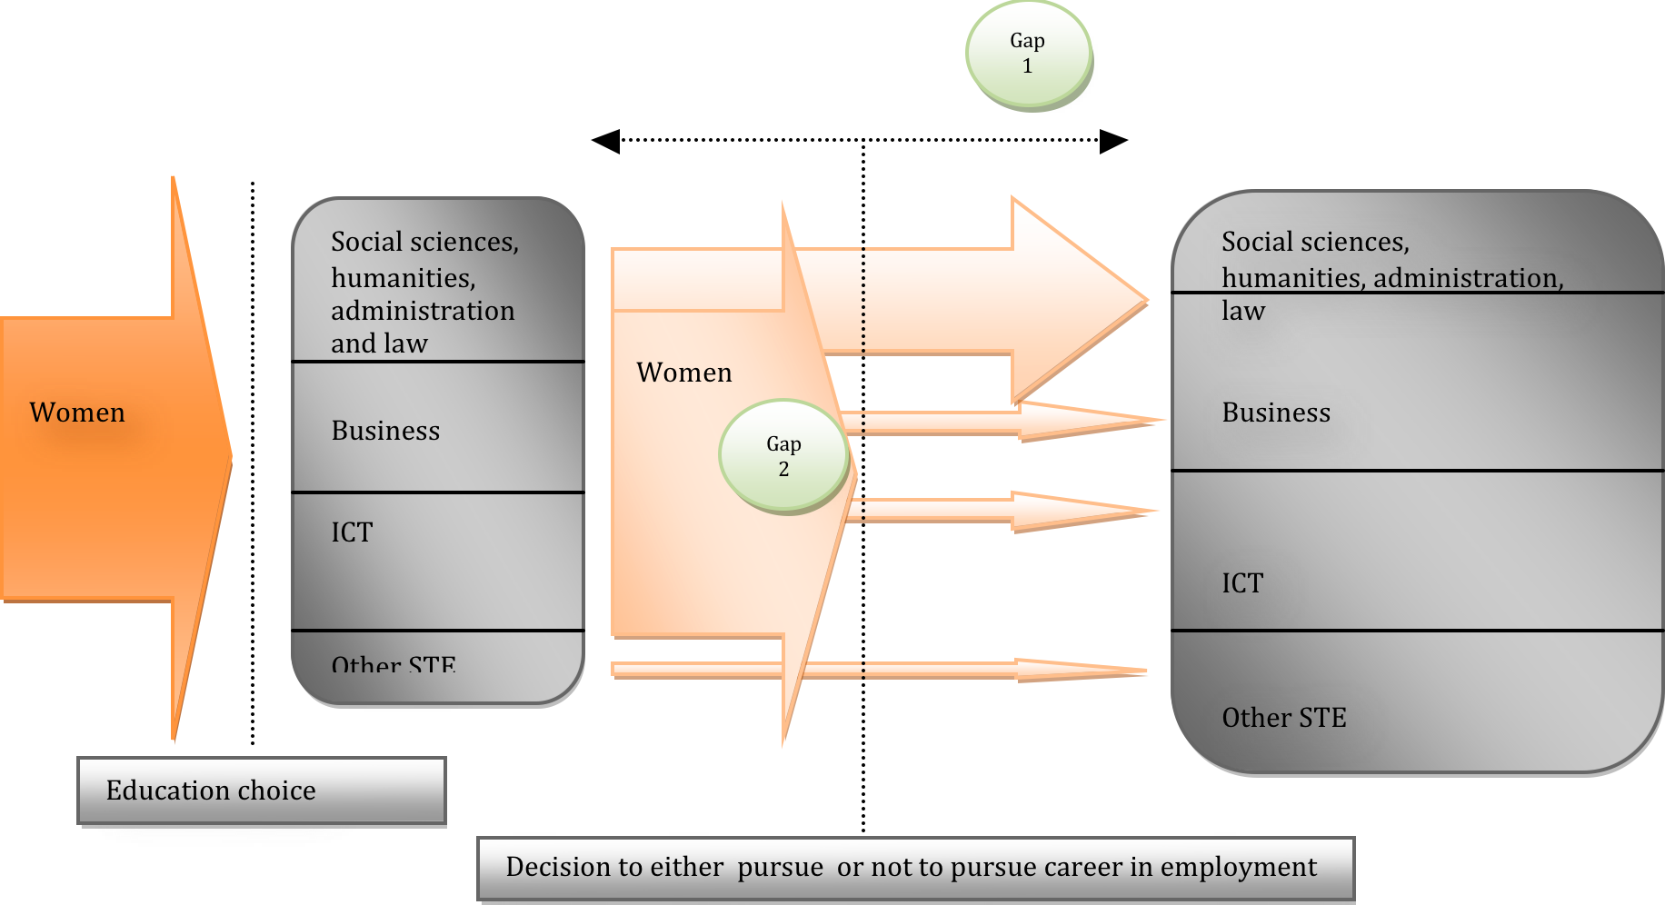
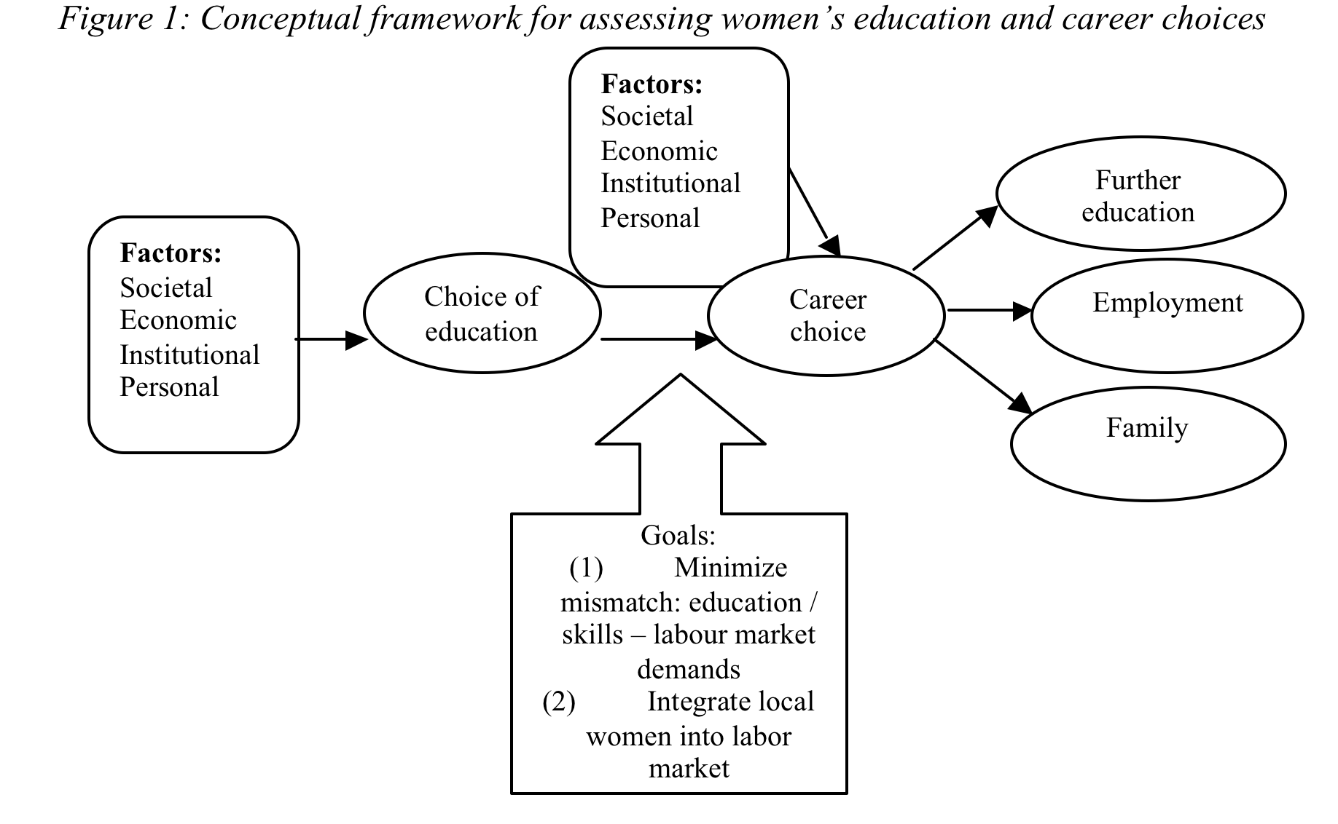
Expanding the Role of Emirati Women in Science, Technology, and Engineering Through Education and Economic Opportunities
Georgeta Vidican (MIST), Diana Samulewicz (MIST)
Noor Aswad (MIST)
Research Objectives
Broader Impact
Assess factors affecting women’s participation in science, technology, and engineering (STE) disciplines
Examine decisions regarding the choice of degree programs.
Assess women’s attitudes towards STE education.
Understand career decisions for Emirati women.
Support building local capacity and assist the transition to a knowledge-based economy in UAE.
Develop culturally sensitive and informed conclusions and recommendations for UAE education policy-makers regarding ways to integrate women in the knowledge society.

Slide 32
System Focus Areas
Energy Generation and Transmission
Sustainable Transportation and Urban Development
Sustainable aviation
Information Systems
Technology forecasting
Electricity transmission networks
Sustainable Design and Manufacturing
Lean manufacturing and operations
Large-scale electricity generation using renewable and sustainable resources
Sustainable cities
Green (carbon-optimized) supply chains
Distributed computing and data storage
Green (energy efficient) information technology and sustainable computing
Life cycle analysis
Models for sustainable manufacturing
Recovery, reuse, remanufacturing, and recycling of components and devices
Notes:
MIT ranking http://web.mit.edu/newsoffice/2009/usnews-0820.html

Slide 33
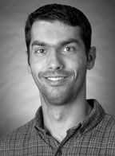





Increasing Efficiency with Enhanced Demand Response in Masdar City
Scott Kennedy, Sgouris Sgouridis, Afshin Afshari (ADFEC), Hossein Haghighat, Alex Koshy
Partially Funded by: Abu Dhabi Future Energy Company
Sustainability Challenge
Efficient buildings and appliances alone may not be sufficient for Masdar City to reach its energy efficiency targets.
Informed end-use behavior from residents is needed.
Desired Impact
Improved residential energy efficiency through a demand response mechanism that incorporates advanced metering, intuitive user interfaces and is validated against actual human behavior.
Project Objectives
Design financial and non-financial incentive mechanisms (peer comparisons, real-time pricing, energy credits) to encourage efficient use of electricity in Masdar Institute residences.
Implement incentives through web-based portal in student residences that communicates with building management system.
Compare effectiveness of different mechanisms through live experiment on student residences.
BMS
System Operator
User Adjusted Set points
(priority)
Centrally Administered Set points
BMS - Mirror
Preferences,
Transactions
Incentive Signals,
Account Info,
Load Data
Environmental and Load Monitoring
Lighting, Water and Cooling
Manual Control
Direct Control and Preset Preferences
Appliances
User Interface
Optional Wireless Control
of Smart Appliances

Slide 34

Water Resources Planning for Masdar City Using
System Dynamic Approach
Pei Yun Sherry Lin and Scott Kennedy
Sustainability Challenge
Masdar city which when finished will become the first carbon neutral and zero-waste city in the world.
Water resources planning is one of the most important subject matters in the city development.
Under the carbon neutral and zero waste premise, what are the optimal desalination and wastewater treatment technologies that will meet the quality required for potable water or water reuse while achieving the energy consumption goal?
Project Objective
Explore the influence of different water supply options and various demand management scenarios on the direct and indirect carbon emissions of the city using a system dynamics model.
Desired Impact
Present a holistic overview of water resources planning in a sustainable city.
Assist Masdar City in achieving its zero carbon goals taking the energy associated with water production and treatment into account.

Slide 35
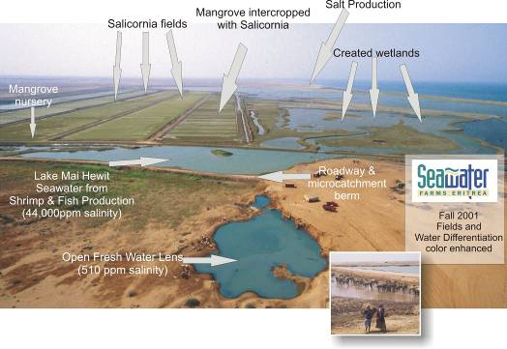
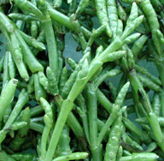
Sustainable Biofuel Production: An Integrated
Seawater Agriculture System
Sgouris Sgouridis, Scott Kennedy, Brian Warshay, Wafa Al Yamani
Sustainability Challenge
Pressing need and growing market for sustainable, cost-competitive, low-carbon biofuels for transport.
Most current biofuel feedstocks are either NOT sustainable (compete with land and water for food production) or NOT low-carbon (use fossil energy inputs)
An Integrated Seawater Agriculture System (ISAS) can potentially provide low-cost bioresources (transport fuels, electricity, aquaculture, biomaterials) at low or net negative GHG emissions.
Project Objectives
Conduct a Life Cycle Assessment of ISAS to evaluate its overall sustainability and environmental, social, and economic impacts and viability
Assess the interactions between the ISAS components (salicornia, mangrove, aquaculture) and conduct research to optimize synergistic relationships.
Desired Impact
Spur commercial development of ISAS for large-scale production of sustinable bioresources in arid environments.
Salicornia bigelovii

Slide 36
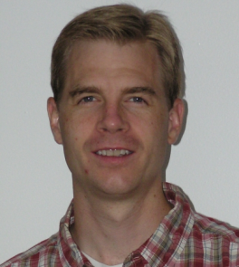
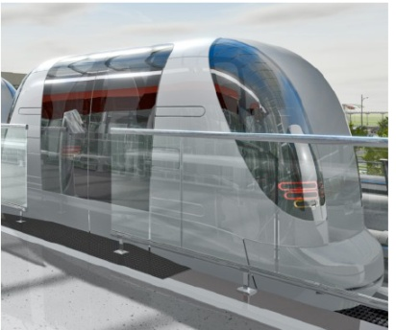
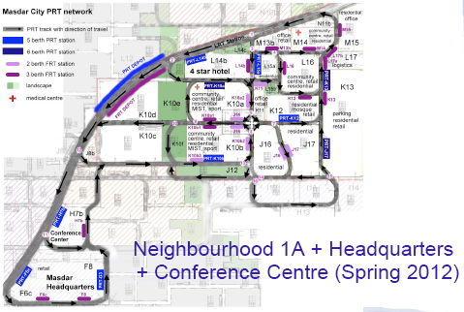
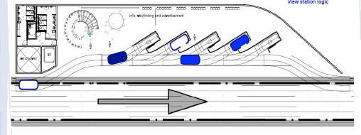
Simulating the Masdar Personal Rapid Transit System
Katharina Mueller (Ulm U.), Sgouris Sgouridis, Jacob Crandall, Edmond Awad, Salman Ahmed
Funded by: Masdar Institute, Mubadala Collaboration potential
Sustainability Challenge
Understand the capabilities of a revolutionary form of transit that offers the convenience of personal vehicles: personal rapid transit (PRT).
Desired Impact
Provide a tool for planning a transportation system for the future.
Develop a robust simulation system that could be extended beyond the confines of Masdar City for applications in cities elsewhere.
Create a platform for general electric vehicle behavior characteristics.
Project Objectives
Simulate the Masdar City PRT system.
Develop algorithms to optimize vehicle allocation, passenger level of service, and energy consumption.
Stress test the proposed system under demand constraints

Slide 37

Student Admissions
Entry Requirements
A relevant undergraduate degree from a recognized university with a minimum CGPA of 3.00 (on a 4 point scale) or equivalent.
TOEFL: score of 577 for paper-based, 233 for computer-based, 91 for internet-based
GRE: general test required (minimum 700 on the Quantitative. Verbal and Analytical as supporting scores)
Statement of objectives and letters from referees.
High grades and scores are prerequisites but do not guarantee admission
Notes:
MIT ranking http://web.mit.edu/newsoffice/2009/usnews-0820.html

Slide 38

Student Admissions - Requirements
Masdar Institute is looking for academically talented students who want
to do pioneering research in alternative energy and sustainable technologies;
  to be part of the first carbon-neutral, zero-waste campus;
  to work with dedicated faculty and fellow students who are passionate about their work and research;
  to make a difference in the world;
  to contribute to society
  to learn … so as to change the world
  Learning
  … to change the world
Notes:
MIT ranking http://web.mit.edu/newsoffice/2009/usnews-0820.html

Slide 39
Graduate Scholarship
Students admitted into Masdar Institute will be offered a full graduate scholarship including:
  100% tuition fee
  Accommodation and medical insurance
  Textbooks and laptop
  A competitive stipend (cost of living allowance)
  Annual travel reimbursement
  Reimbursement of TOEFL and GRE exam fees
  Eligibility for scholarship: Gain admissions

Slide 40
Questions
  Online application at: www.masdar.ac.ae
  Email queries to: admissions@masdar.ac.ae
Notes:
MIT ranking http://web.mit.edu/newsoffice/2009/usnews-0820.html

